Slide 1
Microsoft Power BI
Daniel Ortiz Lopez
Technical Evangelist

Slide 2
The opportunity is bigger than you may think
Diverse data
$1.6T
New analytics
@
How?
Speed
data dividend available to businesses that embrace data over the next four years
More people
Data source: Microsoft and IDC, April 2014
Notes:
Key Points:
Companies that make best use of data and analytics investments stand to capture more value compared to companies that do not
Data is the new currency—the formula is relatively simple as to how we get our returns on data
Talk Track:
If data is the new competitive advantage for business, we want to get granular and specific on how companies can derive business value.
IDC explored the impact of data on business. After surveying more than 2,000 companies, IDC found that there are two categories of businesses: organizations that have taken a leadership position when it comes to data; and those that are not making best use of data. We learned that the leaders—those companies that embraced data—derived significantly more dividends from those investments in data—from increased revenue, improved productivity, and reduced costs.
There is a unique formula that drives this notion of data dividends, or return on data. Data-driven companies focus on several areas:
Capturing diverse data: You can no longer just think about what to do with traditional data types. You need to be open to and capable of collecting a wide array of data—including new data types.
Utilize new analytics: Logical data warehouses are no longer going to extract and transform new data types. You need to explore new analytical capabilities that are suited to new data types and real-time decision making needs.
Deliver to more people: To unlock insights, you need to democratize your data across the organization.
Uncover real-time insights: With the rise of the Internet of Things, and the instrumentation of just about everything, the ability to provide real-time visibility across lines of business represents a big value opportunity.
At the worldwide level, leaders will capture $1.6 trillion more in value from their data and analytics investments over the next four years compared to companies that don’t. This represents a 6 percent higher data dividend for leaders—an opportunity that exists for any individual organization looking to maximize its return on data assets and reap ongoing data dividends.
This means that data really is a new currency of the twenty-first century business economy.

Slide 3
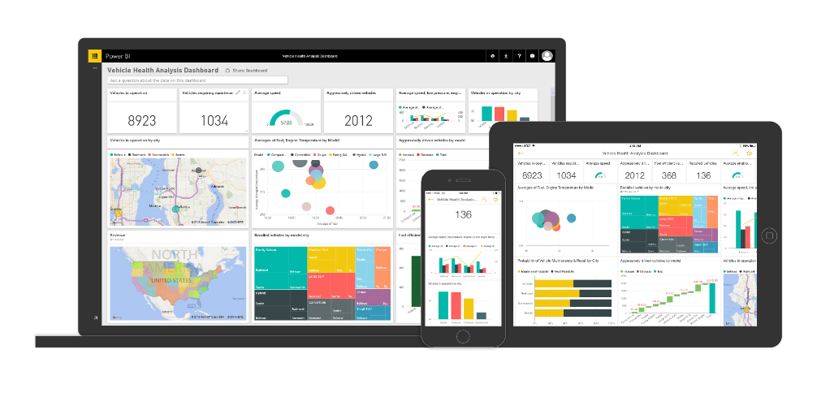














Power BI: experience your data Any data, any way, anywhere
Microsoft Cloud
INTELLIGENCE
Stream Analytics
Machine Learning
Non-Microsoft Cloud
5,000,000+ subscribers 210+ countries
200,000+ organizations
Statistical Analysis
On-premise data
Intelligent Apps
Notes:
Power BI is a cloud-based business analytics service that enables anyone to visualize and analyze data with greater speed, efficiency, and understanding. It connects users to a broad range of live data through easy-to-use dashboards, provides interactive reports, and delivers compelling visualizations that bring data to life.
Through of the course of the preview over 90,000 companies, cross 185 countries have used Power BI. That is a decade's worth of growth in last generation business intelligence where I have to go get software, install software, get servers, get analysts involved, get all sorts of people involved before anyone got any value, that's a long road from "I want to do it" to "I've done it". With Power BI, this is an enormous user population of people that are now connected with data in a way that was either previously very difficult or for many impossible.
Power BI in many ways is a connector between people and the power of the Microsoft Data Platform including data that lives in our cloud, other peoples clouds, or your on-premise systems and also processed by this wide variety of intelligence analytical capabilities that we have - statistical analysis, machine learning, building custom application - all of this technology and the value of converting data into intelligence flows through Power BI.

Slide 4
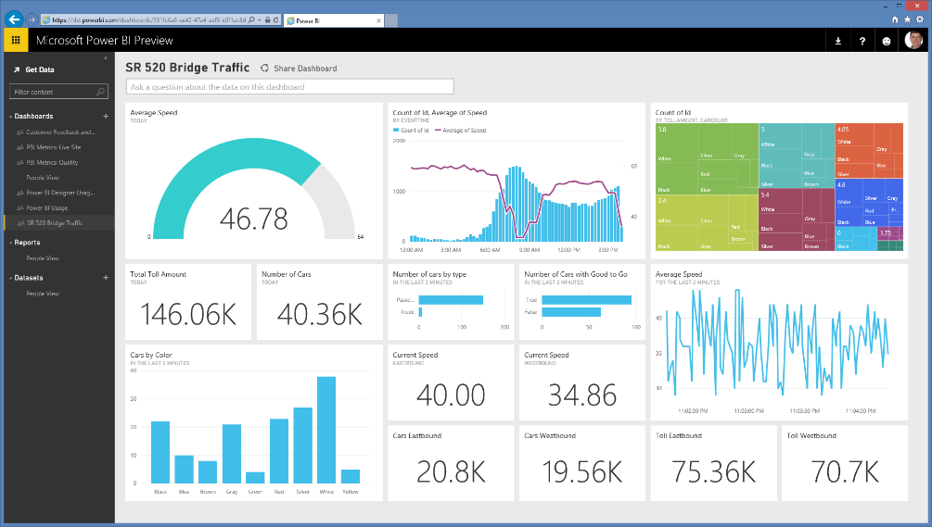
Live dashboards & reports
Live dashboards provide a 360º view of your business
Track your data in real-time with support for streaming data
Drill through to underlying reports to explore in more detail
Pin new visualizations and KPIs to monitor performance
146.03K
145.96K
146.06K
145.84K
39.99K
40.08K
38.84K
40.33K
Notes:
Power BI dashboards
With updates to Power BI customers can now see all their data through a single pane of glass. Live Power BI dashboards show visualizations and KPIs from data that reside both on-premises and in the cloud, providing a consolidated view across their business regardless of where their data lives.
You can then explore their data further by drilling through the dashboard into the underlying reports, discovering new insights that they can pin back to the dashboard to monitor performance going forward.

Slide 5

Mobile apps
Native apps for iPad, iPhone, Android and Windows devices
Receive alerts to important changes in your data
Share and collaborate with colleagues and take action
Notes:
Cross-platform, native mobile apps. In addition to its rich Web client, there are native Windows, iPhone, iPad and Android apps that keep mobile users connected with their data, wherever they may be.

Slide 6







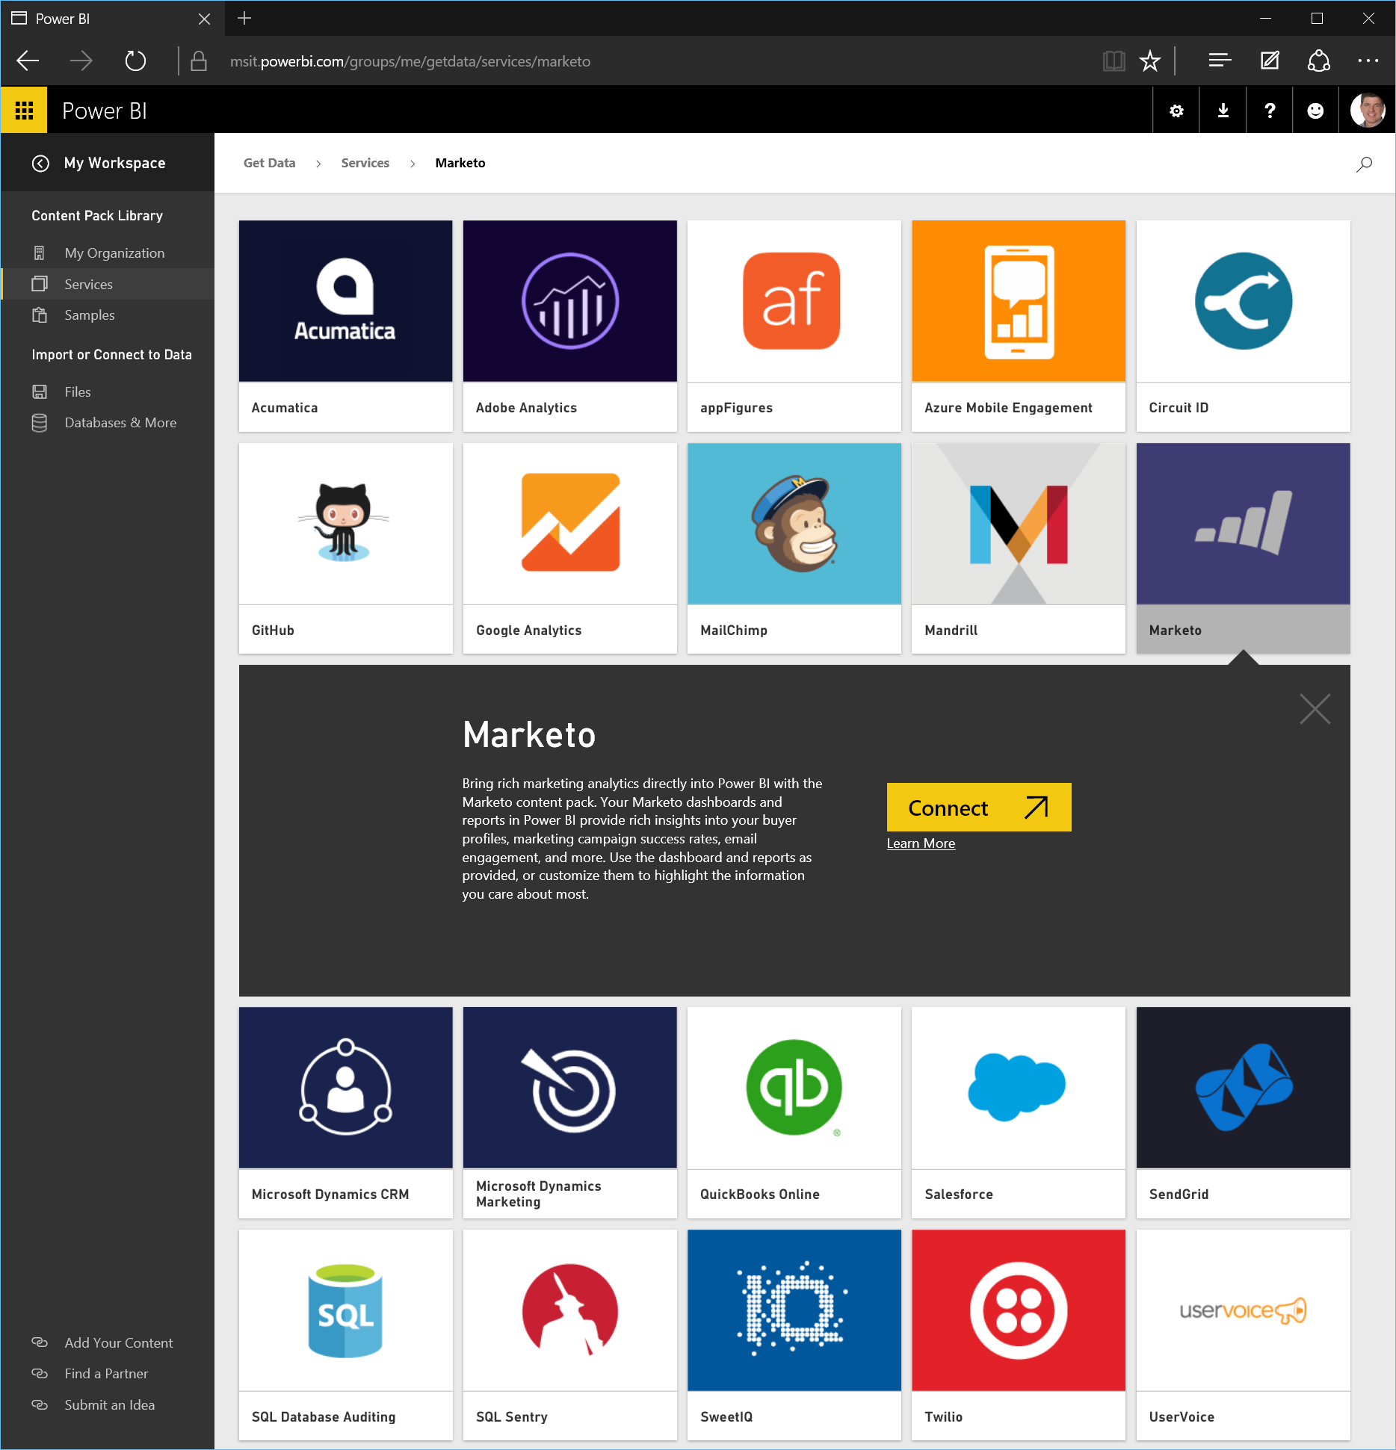




















Get started quickly
Pre-built solutions include dashboards, reports, and data models available out-of-the-box for SaaS services or built by your organization
Dynamics Marketing
Azure Audit
Logs
Microsoft Dynamics NAV
Azure Mobile
Engagement
Application
Insights
SQL Database
Auditing
Notes:
Get started quickly. While even some legacy business intelligence solutions provided “connectors” for SaaS services, Power BI takes it a few steps further by providing complete, “out of the box” content packs for Power BI for these services. When a Power BI user connects to their Google Analytics data, for example, they get a curated collection of dashboards and reports that continuously update with the latest data from the user’s Google Analytics account. We are effectively acting as a team of IT, BI and business analysis professionals on behalf of the user. The result is that more people can connect with and gain insight from their data, faster and more simply than ever before. What used to take days, weeks, months or even years of complex coordinated work now happens quickly.

Slide 7
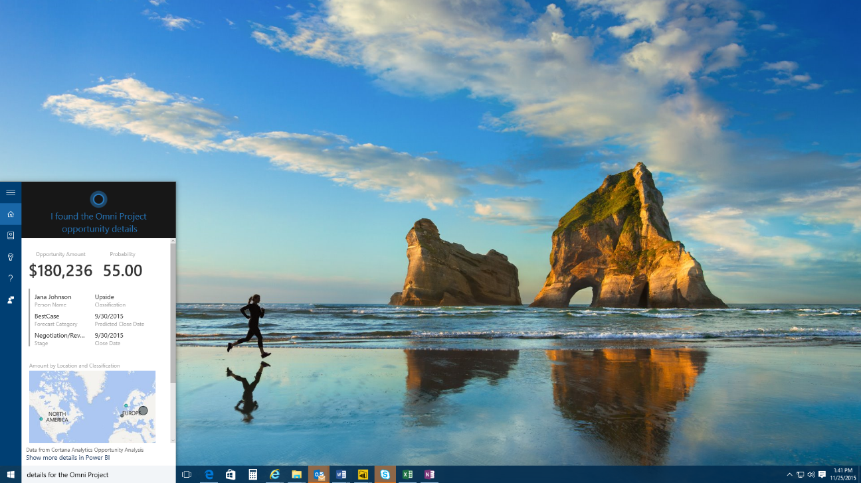
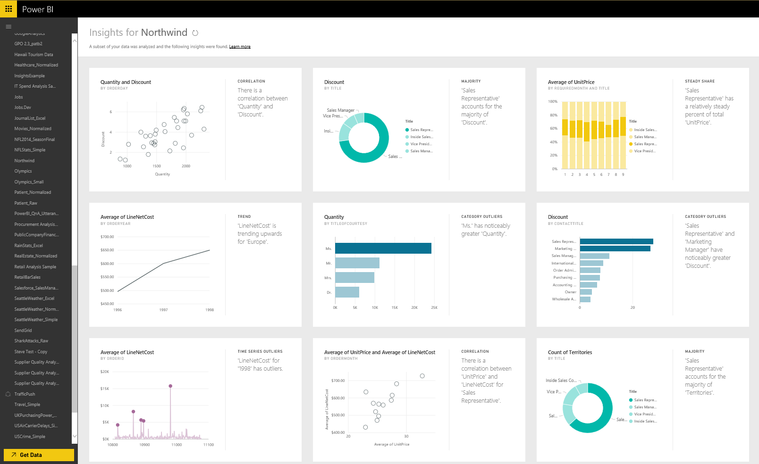
Experience your data in new ways
“Hey Cortana, show me my sales opportunity”
Natural language query—ask questions of your data more naturally
Cortana integration—allows you to access your data from Windows 10
Quick insights—auto discover patterns and insights in your data
Notes:
Natural Language Interface - With Power BI we continue to find new ways to simplify how people analyze and gain insight from data, providing industry leading features such as natural language query. Natural language query provides users with an easier way to interact with their data, allowing them to type questions of their data and receive answers in the form of live visualizations. Power BI integration with Cortana allows you to now ask these question directly from Cortana and to have answers from your Power BI data surfaced to you by Cortana. These data driven answers can range from simple numeric values (“revenue for the last quarter”), charts (“revenue over time”), maps (“revenue by region”) or data represented through any of the other Power BI data visualizations. Combined with the Cortana Analytics suite, this opens up amazing new opportunities to use Cortana to enable your business, and your customers' businesses, to get things done in more helpful, proactive, and natural ways.
Quick Insights - providing a new ways to help users find hidden insights in their data. The new Quick Insights feature allows users to automatically scan and detect patterns and trends in the data that they publish to Power BI. Through a partnership with Microsoft Research, the Quick Insights feature uses a growing list of algorithms to automatically discover and visualize correlations, outliers, trends, seasonality, change points in trends, and other factors in your data in seconds.

Slide 8
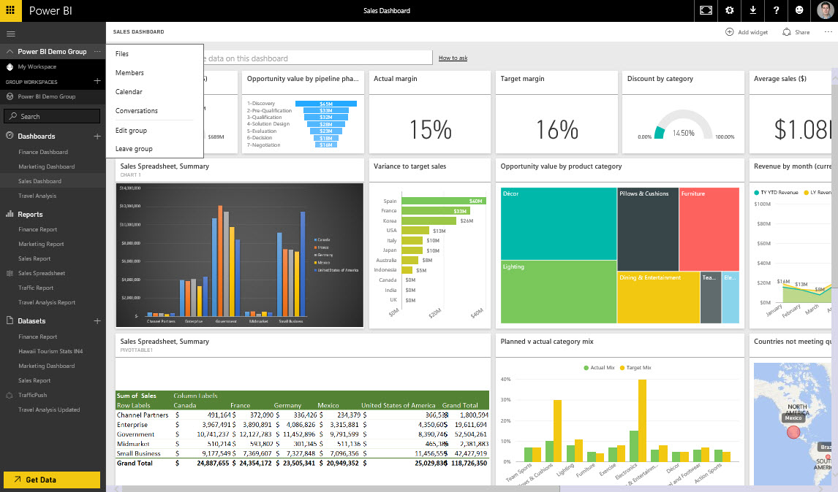
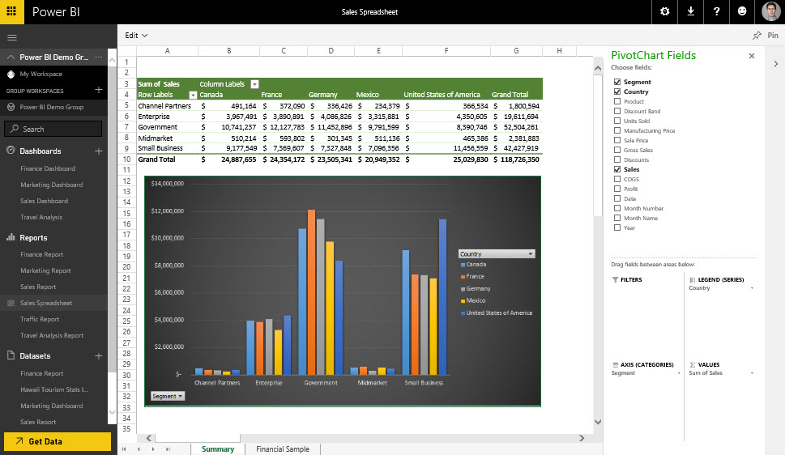
Seamless integration with Office 365
Team collaboration through support for Office 365 Groups
Seamless navigation to other workloads in Office 365
Use Excel data and pin live charts to your Power BI dashboards
View Excel spreadsheets through support for Excel Online
Notes:
Team collaboration is enhanced with Power BI integrated with Office 365. Create Office 365 Groups so that only the members of the group can view and edit specific reports and dashboards. Navigate from Power BI to any of the other Office 365 workloads as you view conversations, documents, notes etc all in the context of your work group.
Take your Excel data to the next level with Power BI. Pin live Excel charts and ranges to a Power BI Dashboard or share your spreadsheets to Power BI and view them through Excel Online.

Slide 9
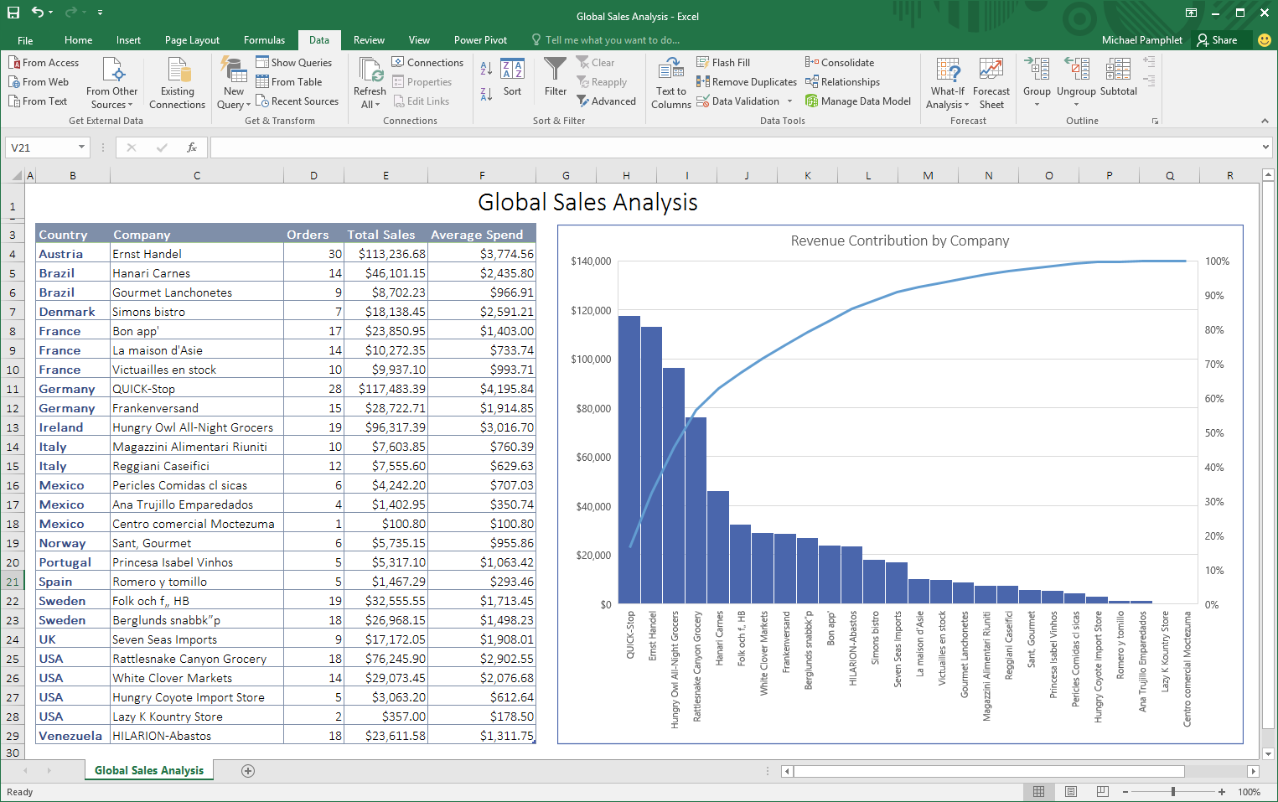
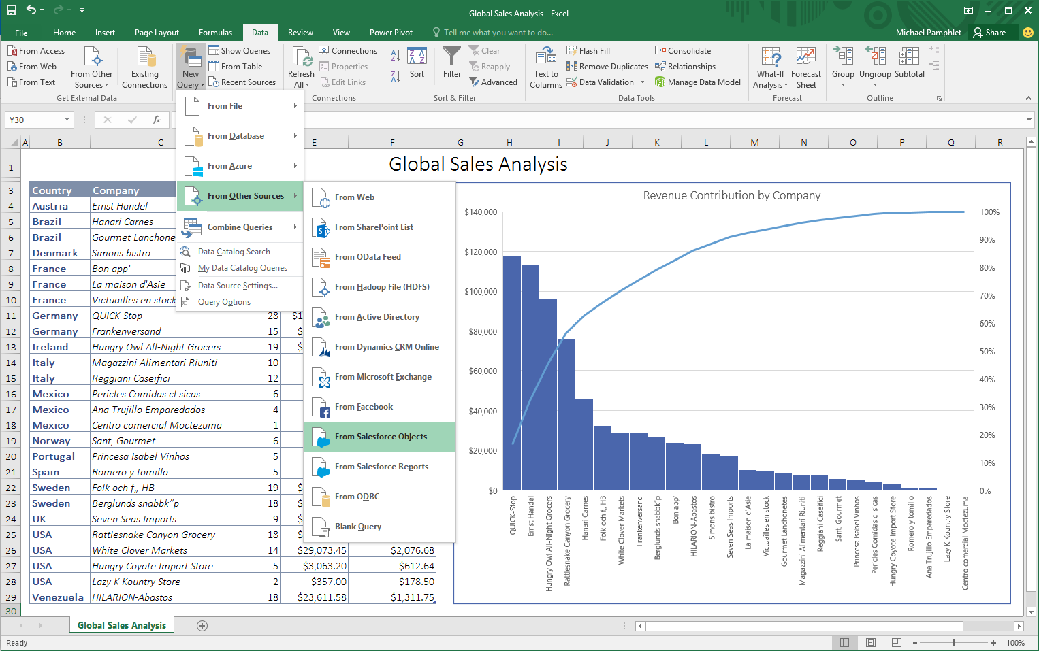
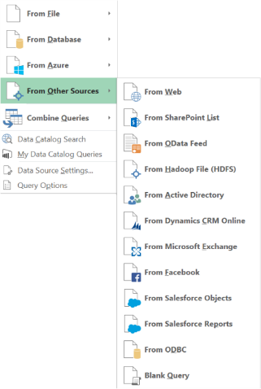
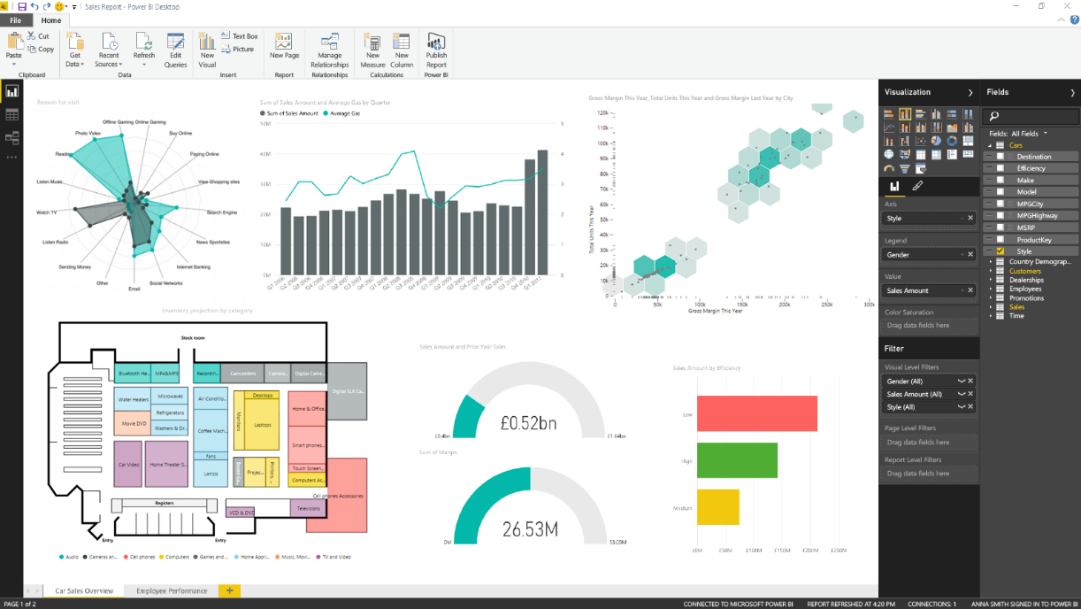
Powerful self-service analysis
Excel
Ad-hoc analysis for blending structured and unstructured data together for analysis in familiar spreadsheets
Power BI Desktop
Visual drag-and-drop data exploration and interactive reporting on a freeform canvas
Notes:
Excel as the world’s most flexible and widely used data analysis tool, providing familiarity and flexibility when working with data in the context of the Excel grid and native charts and graphs. Excel uniquely allows users to perform ad-hoc analysis, blending structured and unstructured data together for analysis in the familiar Excel environment.
We also introduce Power BI Desktop an a tool for business analysis to create visually interactive reports for data exploration. Power BI Desktop provides a free-form canvas for drag and drop exploration of your data, an extensive library of interactive visualizations, and authoring experience to create visual and interactive reports for business end users to view and explore.
In addition we provide the ability for you to create your own Power BI custom visualizations. We have contributed the source code of our visualization framework and the complete collection of native visuals supported by Power BI and Power BI desktop to the open source community under the permissive MIT license. This paves the way for completely custom visualizations in Power BI and Power BI Desktop. These can be uploaded to your Power BI tenant, or attached to a report, providing maximum flexibility for how you visualize your data.

Slide 10
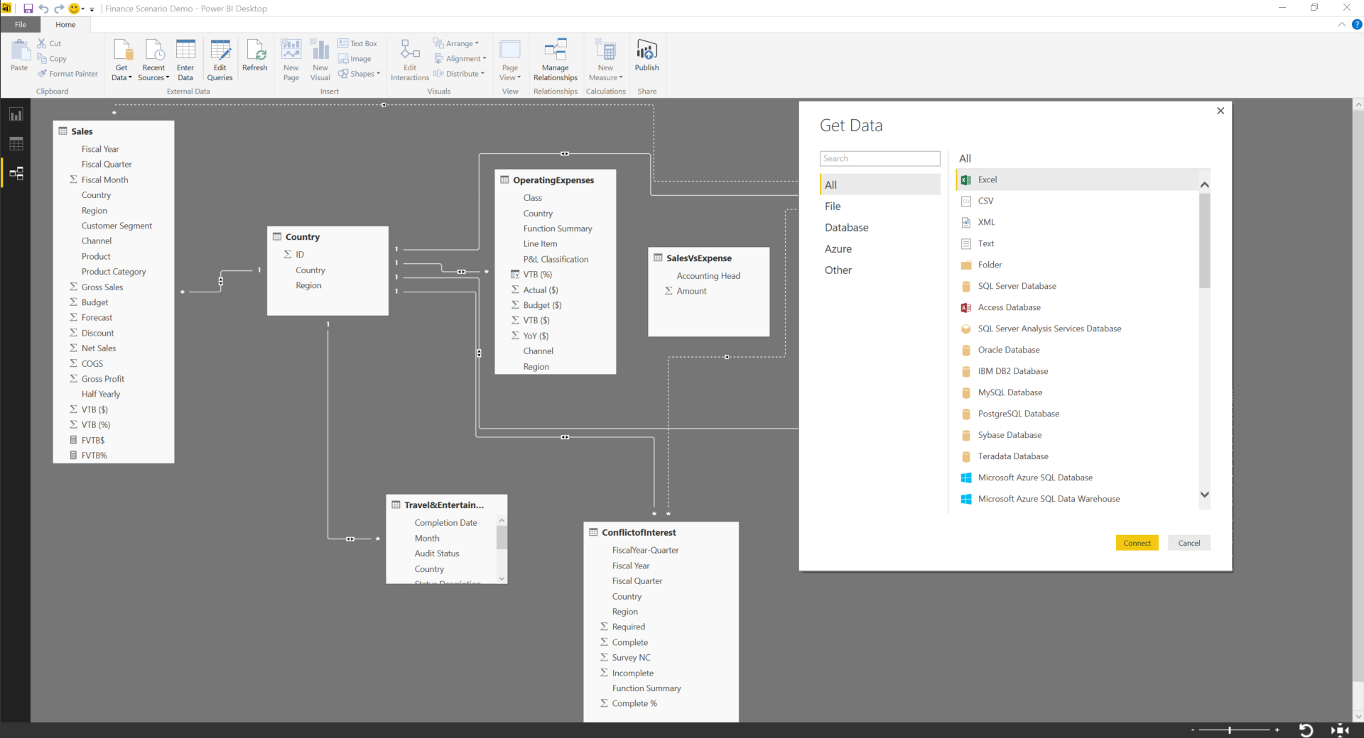
Connect to all the data around you
One data preparation experience across Excel & Power BI Desktop
Data Source
Connect to a broad range of data across on-premises and cloud
Shape, transform, and clean data for analysis
Join and model data from multiple data sources and different types
Extend your analysis with support for technologies such as R for advanced analytics
Data Source
Data Source
Notes:
Connect all the data around you. How can users combine data from multiple sources and of multiple data types, across on-premises and cloud, into a set of reports and dashboards? This is where Power BI Desktop and Excel come in. These are powerful analytical tools for use by business analysts – with them analysts can connect to a wide range of data sources; cleanse, transform and model interrelationships between the data; explore the resulting mashed up datasets and create beautiful, interactive reports or powerful spreadsheets.
One data preparation experience across both desktop tools. We put the same based capabilities and engines for data preparation into both tools. Anyone who knows how to use one tool will automatically know how to use the other. This full data preparation experience includes the following set of capabilities:
Connect to a broad range of data across on-premises and cloud sources. In the connection dialog of both tools we provide a long list of data connectors for sources across flat files, databases, SaaS applications, Big Data technologies such as Spark, and others, and we continue to add to this list on a regular basis. With these data connectors business analysts can connect to all the data they need to access for their analysis.
We also provide powerful capabilities that allow users to shape, transform, and clean this data for analysis. Data is rarely in the right format for analysis and a self-service business analysis tool must provide the flexibility to transform and clean data before it can be properly analyzed. We provide these capabilities as an integrated part of the data preparation experience, providing a more flexible, and ultimately a faster, experience for business analysts to work with data and build reports.
We provide one of the industries leading modeling experiences, for joining this data from multiple data sources together across different types and sources, for analysis and for creation of custom calculations and measures. Leveraging the same powerful modeling capabilities and in-memory engine as in our server technology (SQL Server Analysis Services), we provide business analyst with a complete range of modeling capabilities.
We also provide extended capabilities allowing analysts familiar with technologies such as R to incorporate this work into their reports incorporating advanced analytic to their analysis.

Slide 11
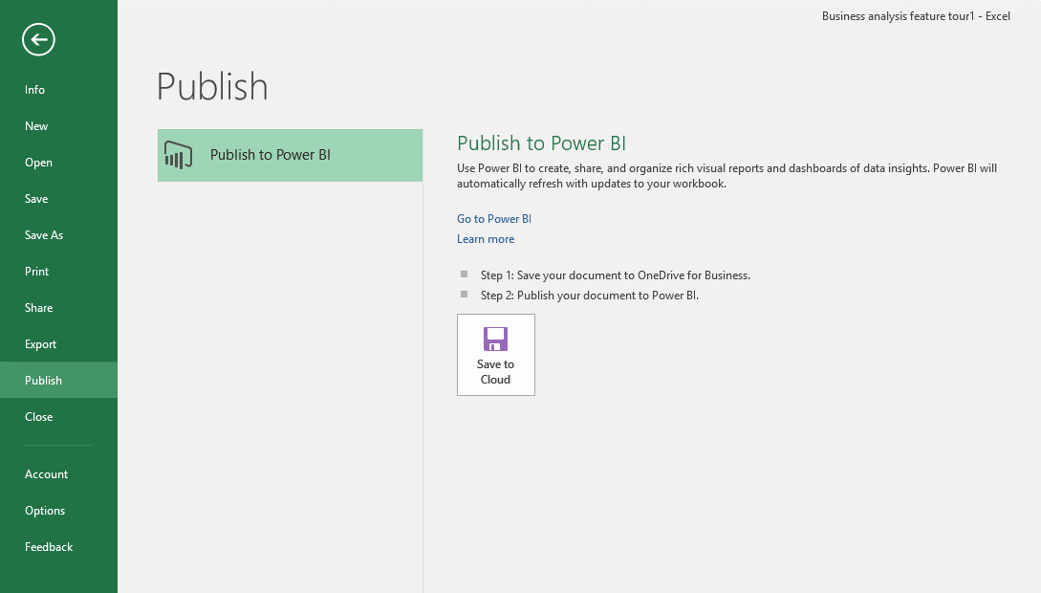
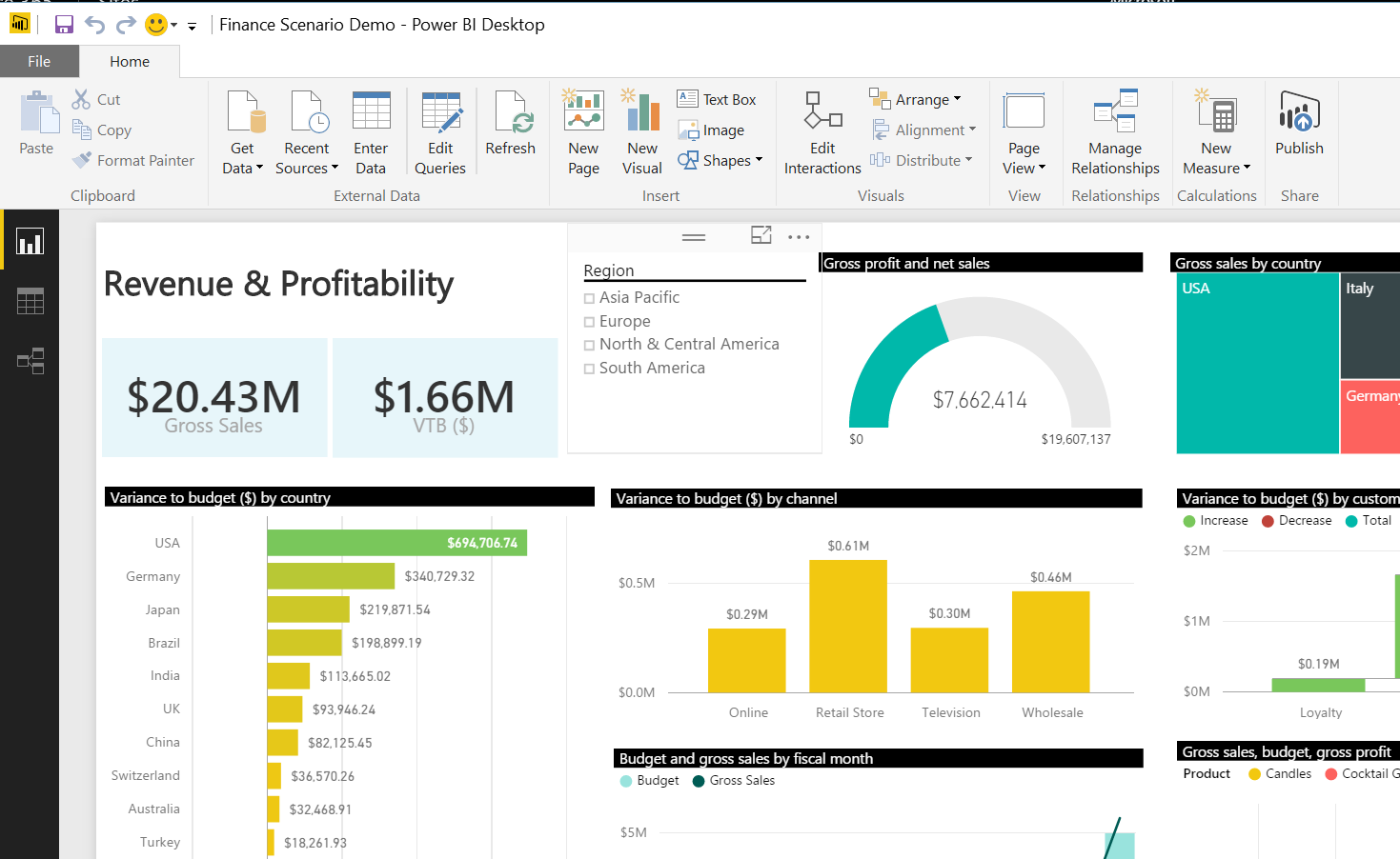
One-click publish to Power BI
Excel
Power BI Desktop
Notes:
Both Excel and Power BI Desktop are seamlessly integrated with the Power BI service. With a single click, these live spreadsheets and reports can be published and refreshed from the Power BI service for ease of access for business users across the organization.

Slide 12
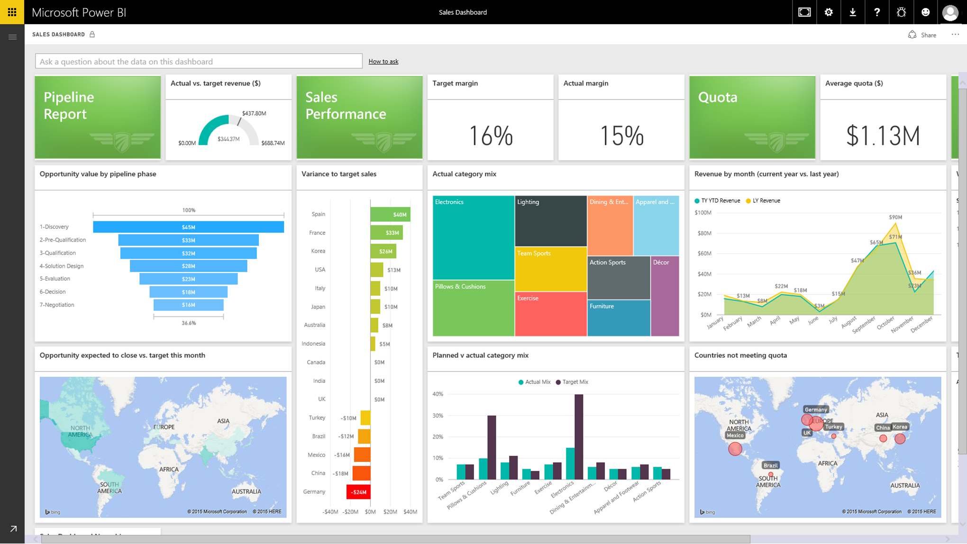
Deploy quickly with a hybrid solution
Live Power BI reports & dashboards
Access on-premises data any way you like
Scheduled refresh
Live connection
Connect to on-premises SQL Server Analysis Services models
Tabular and multidimensional
Cloud
Live connection or
scheduled refresh
On-premises
SQL Server Analysis Services
Data Source
Notes:
Connect live to on-premises Analysis Services models
Realize the benefits of a cloud based BI solution without having to move your data. With Power BI gateways you can create a secure connection to SQL Server Analysis Services from Power BI. When users view and explore dashboards and reports the system will interactively query the on-premises cube to fetch the data using the user’s credentials. With this hybrid solution, you can continue to manage and secure your data on-premises, removing the need to have data reside in the cloud.
The gateways provide the flexibility you need to meet individual needs, and the needs of your organization.
Live connection option are live Query to SSAS or direct query to SQL Server data sources and other data sources.
Scheduled refresh to all supported data sources.
FAQ:
How does security work with the new SQL Server Analysis Service connector?
Power BI customers can benefit from the role level security in SQL Server Analysis Services. The Power BI user name is passed through to on-premises Analysis Services and appropriate role-based security. Analysis Services resolves the user name to an authorized user via Azure Active Directory (more info:: http://support.powerbi.com/knowledgebase/articles/505323-why-you-need-dirsync-to-connect-to-on-premises-ana) and then applies appropriate role-based security to restricted access.

Slide 13
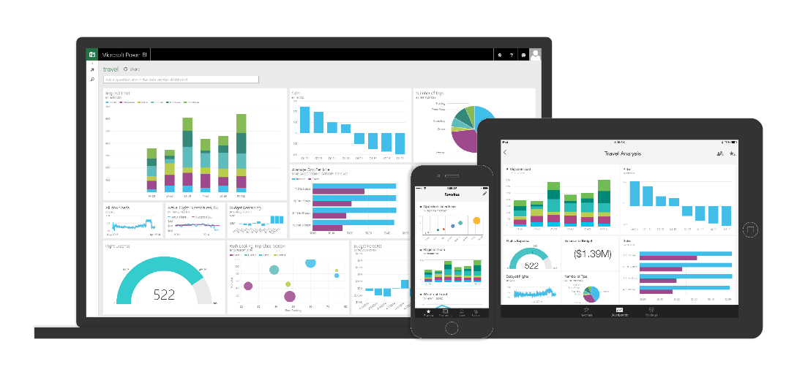
Seamless integration across the Microsoft Data Platform provides quicker and more cost effective deployment for any data project
Data Warehouse
Internet of Things
Big Data
Advanced Analytics
Notes:
To allow customers to get stated quickly we now provide new out-of-the-box connectors for Salesforce, Zendesk, Marketo, SendGrid, GitHub, Dynamics CRM Online, and Dynamics Marketing. With an existing subscription to one of these services, customers can login from Power BI and get rich content in the form of dashboards, reports and datasets.

Slide 14
Power BI for developers
Embed Power BI experiences directly into your public facing websites and blogs
Extend Power BI and your reach with organizational content packs and custom visuals
Integrate user-defined Power BI experiences into your app
</>
Notes:
Speaker Notes-
We are making investments in Power BI to make it a compelling platform for developers and ISVs
Now one can embed Power BI visuals in websites and blogs for public anonymous access. This will allow enterprises to tell public facing data stories with ease .
2. Power BI is an open and extensible platform. You can develop custom visuals on demand to support you business requirement . Developers can started quickly with Microsoft’s open-sourced, production-quality visualization code.
3. You can create Power BI organizational content packs for your users and groups to consume pre-configured Power BI solutions with ease
4. Integrate user-defined Power BI experiences into your custom apps
Easily enable your users to pull their Power BI tiles, dashboards or reports into your custom apps with Power BI integration APIs
We have a strong roadmap for Power BI as a platform for developers. Please visit dev.powerbi.com for latest updates and upcoming releases

Slide 15

Metro Bank
“Microsoft Power BI is our only BI solution. We had a solution previously that was fine for us as a brand new startup organization. But as we grew, we needed something more dynamic, more visually appealing and more user-friendly for our colleagues. Power BI fits the bill in all of those respects.”
Bruce Rioch, Head of Business Information and Customer Systems
Notes:
Metro Bank, the first new “High Street” bank in more than a century, has 27 stores and more than 350,000 customer accounts with a target of growing to 1M customers by 2020.
The first time the bank evaluated Power BI they had just launched a mobile banking solution:
The bank launched mobile banking on a Tuesday.
On Thursday the team gathered the first data on how customer were using it.
On Friday, they used the Excel and the new features to clean up and sift through the data.
Over the weekend they spent 2 hours creating a Power BI dashboard to give executives and colleagues a highly visual, at-a-glance view of how many people were using it to make payments, view balances and transactions, find a nearby branch, and perform about 20 other functions.
Today:
Today Power BI is used throughout the bank understanding how its customers interact with all its services, including stores, online, telephony, and mobile. Analyzing this information so that they can fine-tune its services and reach its million-customer goal.

Slide 16

NHS
“Linking data for analyses was something we couldn’t do before. With Power BI, it’s simple. Power BI makes the hard things easy. Everything becomes possible.”
Philip Dean,
Head of Department of Pharmacy and Quality Control, North Tees and Hartlepool National Health Services Trust
Notes:
https://customers.microsoft.com/Pages/CustomerStory.aspx?recid=2546

Slide 17

It’s easy to get started…
PowerBI.com

Slide 18

SQL Server 2016
Comprehensive, enterprise-ready BI platform
Visualization
Power BI
Pin paginated report items to
Power BI dashboards
Mobile and paginated reports
Modeling
Access
on-premises data
Tabular
Multidimensional
On-premises
Cloud
Notes:
Key points: SQL Server 2016 delivers a comprehensive, enterprise-ready BI platform that enables you to transform data into actionable insights to drive the business in new ways.
Talk track:
In SQL Server 2016 we continue to invest in on-premises and hybrid business intelligence capabilities enabling organizations to build on their existing investments and create, manage and consume business insights on-premises and the cloud.
Both SQL Server Reporting Services and Analysis Services receive major enhancements and deliver modern and mobile reporting and powerful modeling capabilities.
SQL Server 2016 also enables hybrid BI scenarios. You can benefit from your existing investments by accessing on-premises data sources from the cloud without the need to move the data. To monitor all important charts and metrics in one place you can pin paginated report items to your Power BI dashboard and then open the report to drill down into the details.
In this presentation we will provide you with an overview of our short term and long term roadmap for SQL Server reporting and Power BI as well as walk you through some of the key enhancements in BI capabilities in SQL Server 2016.

Slide 19
Enterprise scale models with in-memory technology built-in
SQL Server Analysis Services 2016
Easily create models
Use SQL Server Analysis Services as a semantic model without storing data High performance DirectQuery for Tabular
Make it easier to create powerful models Tabular modeling capabilities and performance
Improve manageability and security Provide additional tools for administrators
Strengthen multidimensional Performance and other updates
IT pro
BI consumers
Faster time to insight
Share insights faster
Business analyst
Notes:
Key Points: Scale models with in-memory technology built in – enabling faster time to value. Transform complex data in your organization into valuable assets that can be used across the business. Easily transform complex schemas into a more business user friendly environment to provide faster time to insights and increase user adoption.
Talk Track:
The investments in SQL Server Analysis Services can be grouped into 4 major themes:
Use Analysis Services as a semantic model without storing data IT spends a lot of time in developing a data architecture for their organization. To give the business users access to all this data in a simple and intuitive manner they build a semantic model on top of the data. Some organizations have made significant investments in a fast, large infrastructure that contains all their data, moving all that data to SSAS might not be desired due to processing times and size considerations. Direct Query mode enables organizations to take advantage of the BI Semantic Model, make data more consumable and provide direct access to their data infrastructure, no data is loaded into Analysis Services.
Make it easier to create models The several enhancements are planned to help IT to more easily create powerful tabular models
Improve manageability and security for both Multidimensional and Tabular models In SQL 2016 we plan to deliver additional tools and capabilities for administrators.
Strengthen Multidimensional The following enhancements are planned for Multi-dimensional models.
Performance updates
Visualize and explore existing models with Power BI and Power BI Desktop
Drill-through multi-selection support with Excel 2016 (example when using slicers)

Slide 20
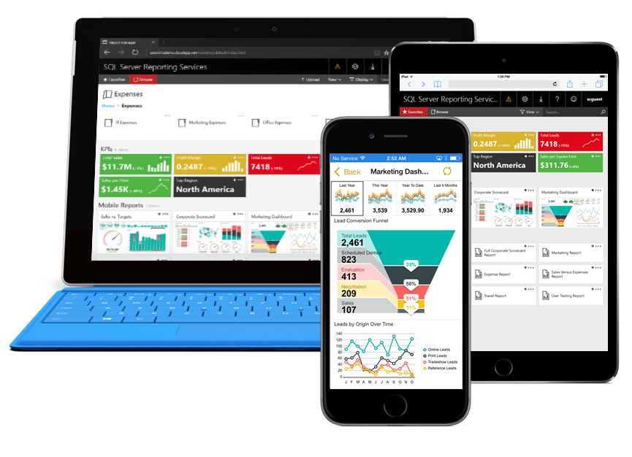
SQL Server Reporting Services 2016
On-premises solution for deploying and managing reports
Paginated reports Design beautiful documents using updated tools and new features
Mobile reports Create responsive, interactive reports optimized for mobile devices
New web portal Consume both types of reports in one web portal using modern browsers
Notes:
Key Points:
This is the overview slide of what’s new for Reporting Services in SQL 2016.
Talk Track:
With the release of SQL Server 2016 Reporting Services brings modern design to enterprise reporting.
SQL Server 2016 enhances Reporting Services with modern design tools
Modern Report Builder look and feel and Visual Studio 2015 support
In SQL 2016 we will enable mobile reports that are optimized for mobile devices and can be consumed on any device and form factor
And a new web portal experience, which is built on HTML5 and optimized for modern web browsers.

Slide 21
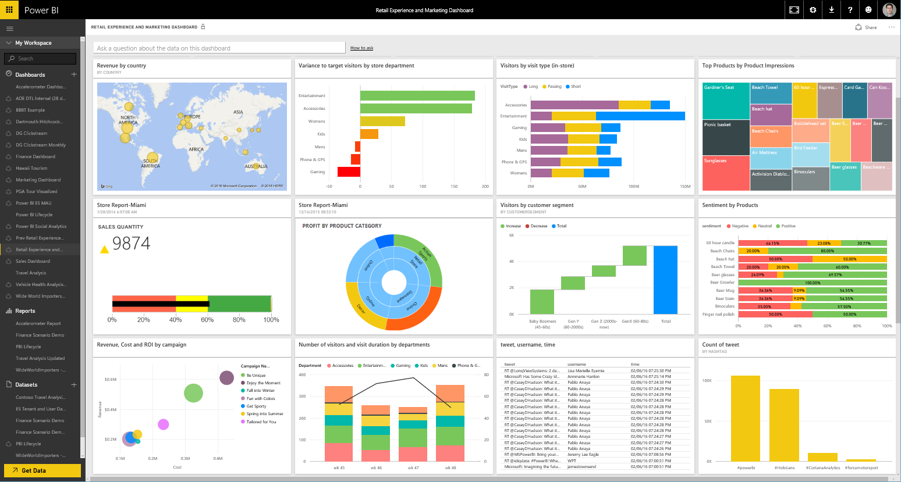
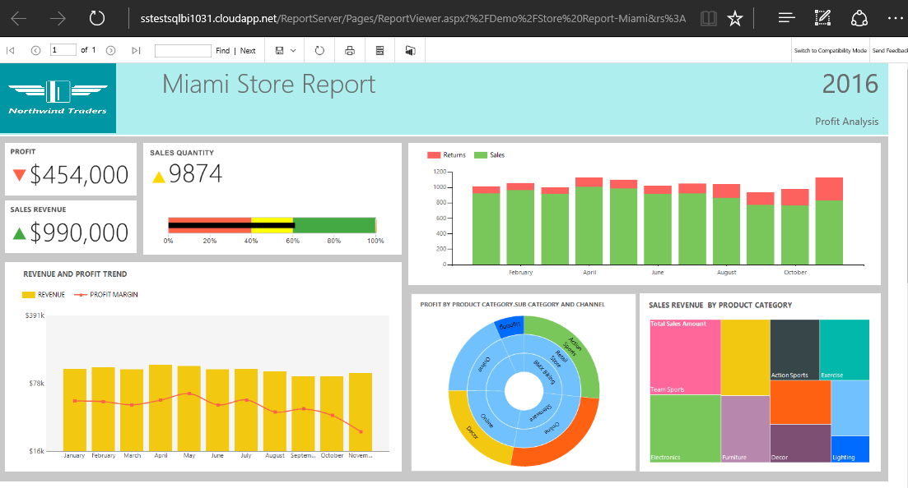
Pin report items to Power BI dashboards
Get more from existing Reporting Services investments
Monitor the most important metrics and trends in one place
Pin charts, gauges, maps, and images as tiles to Power BI dashboards
Drill through to source reports
Refresh tiles on a schedule
Power BI
Reporting Services
Notes:
Key Points:
View most important metrics in one place by pinning Reporting Services paginated report items to your Power BI dashboard.
Talk track:
In addition to using Reporting Services on-premises, you can now use Power BI dashboards to monitor the metrics and trends that matter to you. You can harness your on-premises reporting investments and extend it to the cloud. Business users can pin paginated report items to their Power BI dashboards, enabling them to monitor the most important metrics and trends at a glance in one place. The original reports remain one click away, ensuring that people can drill through to the details when necessary.

Slide 22

Create powerful reports with Power BI desktop
Discovery & exploration – integrated experience for connecting and preparing data for visual data exploration
Easy report authoring – freeform canvas for drag-and-drop report design
Custom visualizations – create your own custom interactive visualizations
R integration – extend your reports with advanced analytics through support for R
Notes:
Power BI Desktop is a self-service BI tool designed to allow users to pull data together from multiple different data sources. Transform and clean that data. Model and add custom calculations. And then visually explore and create interactive reports that can be easily published and shared through the Power BI service.
In addition – you can now create your own custom visualizations though our open source visualization framework. More information available at powerbi.com/visuals

Slide 23


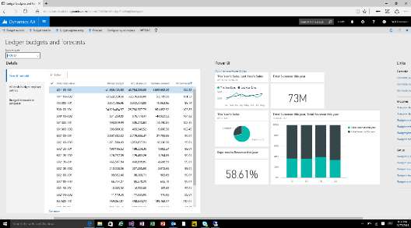
Microsoft business intelligence & analytics
Analysis/authoring
Delivery
Web
Excel
SQL Server Reporting Services
Power BI
Power BI Desktop
On-premises
Cloud
SQL Server Mobile Report Publisher
Mobile
SQL Server Report Builder/
Report Designer
Azure data services
Office 365
SQL Server Analysis Services
Apps
Databases and other data sources
Dynamics
Partner apps
On-premises data
Microsoft cloud data
Non-Microsoft cloud data

Slide 24
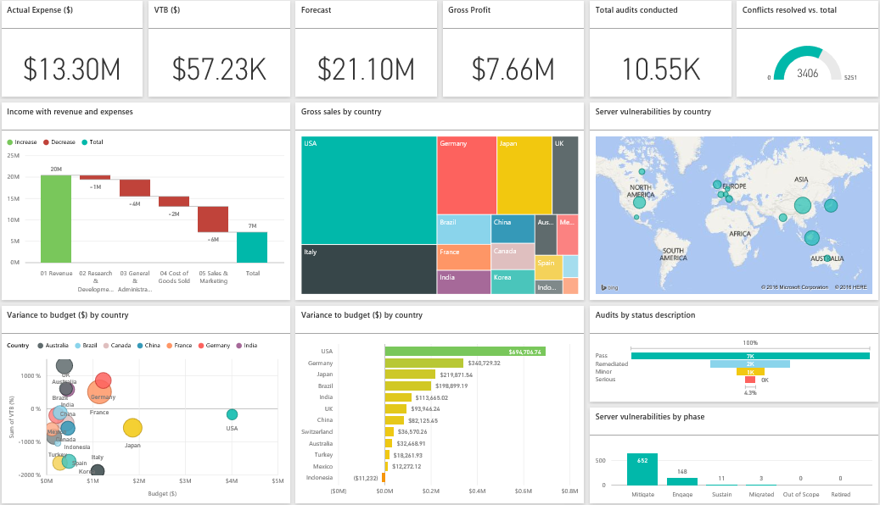
Power BI
Power BI transforms your company’s data into rich visuals and analytics. Stay in the know, spot trends as they happen, and push your business further
Notes:
Key message:
Power BI is a business analytics service. With Power BI you can now see your data through a single pane of glass. Live Power BI dashboards and reports show visualizations and KPIs from data residing both on-premises and in the cloud, providing a consolidated view across your business regardless of where your data lives. It enables someone to better visualize your business and provides a canvas to build the connections to create a 360-degree view of your business.
Talking points:
This is Power BI in a nutshell. The Power BI service offers a simple, intuitive experience for interacting with data. From creating and sharing dashboards to exploring and enhancing reports, Power BI makes it easy to engage with data from heterogeneous sources, fueling faster, more insightful business decisions. With Power BI, you get a rich, consolidated view of key information, no matter where all of the underlying data is stored.
We’ll look at the key benefits and differentiators on the next slide

Slide 25
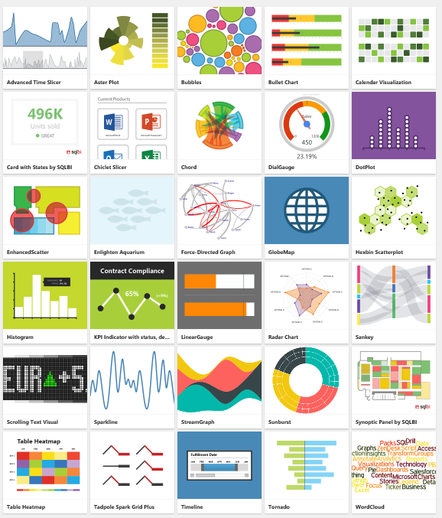
Visualize any data any way with Power BI custom visuals
Notes:
We’re enabling developers to easily add custom visuals into Power BI for use in dashboard, reports and content packs. To help you get started, we’ve published the code for all of our visualizations to GitHub. Along with the visualization framework, we’ve provided our test suite and tooling to help the community build high quality custom visuals for Power BI. All of this is available as an open source project on GitHub. You can also visit www.powerbi.com/visuals to visit our community authored visuals gallery , download visuals and get started.

Slide 26



Customer success stories
Self-service BI
Big Data
Advanced Analytics
IoT
MRWPCA Monterey, CA Water
“Microsoft Power BI is our only BI solution. We had a solution previously that was fine for us as a brand new startup organization. But as we grew, we needed something more dynamic, more visually appealing and more user-friendly for our colleagues. Power BI fits the bill in all of those respects.”
“By using Microsoft Azure HDInsight, SQL Server, and Power BI we can collect, analyze, and generate near-real-time BI with Big Data collected from social media feeds, GPS signals, and data from government systems.”
“Microsoft HDInsight, Azure ML, and Power BI help Ziosk gain dining insights from more than 77,000 tabletop tablets deployed at Chili's and other restaurants.”
“By combining Azure Stream Analytics, Power BI and Candi’s unifying IoT Platform, we are able to quickly and cost-effectively connect and present big data from industrial IoT devices for remote monitoring, analysis and control.”
Thad Chapman
Co-Founder
Artis Consulting
Steve Raschke
CEO
Candi Controls, partner
Lluis Sanz Marco
Director of Information
Municipal, Institute of Information
Bruce Rioch
Director Microsoft Technologies & BI
Metro Bank
Notes:
Some key quotes from Microsoft customers using Power BI – across different areas
Visualization: Metro Bank https://customers.microsoft.com/Pages/CustomerStory.aspx?recid=22883
Metro Bank, the first new “High Street” bank in more than a century, has 27 stores and more than 350,000 customer accounts with a target of growing to 1M customers by 2020. The first time the bank evaluated Power BI they had just launched a mobile banking solution:
The bank launched mobile banking on a Tuesday.
On Thursday the team gathered the first data on how customer were using it.
On Friday, they used the Excel and the new features to clean up and sift through the data.
Over the weekend they spent 2 hours creating a Power BI dashboard to give executives and colleagues a highly visual, at-a-glance view of how many people were using it to make payments, view balances and transactions, find a nearby branch, and perform about 20 other functions.
Today Power BI is used throughout the bank understanding how its customers interact with all its services, including stores, online, telephony, and mobile. Analyzing this information so that they can fine-tune its services and reach its million-customer goal.
Big Data – City of Barcelona https://customers.microsoft.com/Pages/CustomerStory.aspx?recid=1939
To help design and deploy its Big Data solution, the city teamed with Bismart, a Microsoft Big Data partner and Microsoft Business Intelligence Partner of the Year. Bismart and Barcelona created new services designed to improve efficiency and transparency. These include an Open Data service that collects and centralizes all public information from Barcelona’s City Hall. Another service uses a dashboard with key performance indicators that measure data from 100 systems about topics such as public transportation, the economy, and population demographics. And Barcelona also used the Big Data platform to streamline the planning for Spain’s largest festival, La Mercé, by analyzing petabytes of real-time data from social media feeds, financial transactions, GPS, traffic, and weather data, parking records, web site visits, and more.
Machine Learning – Ziosk https://customers.microsoft.com/Pages/CustomerStory.aspx?recid=18294
Predictive analytics to do targeted marketing and promotions on the Kiosks based on user behavior and historical data. With Power BI each manager would see a different slice of the data, based on his or her role. A Ziosk marketing manager might see an aggregation based on the company’s 77,000 (as of early 2015) devices. A corporate restaurant manager might see data for the entire chain, with breakdowns by region and restaurant. A manager in the restaurant might see data to show where and when to redeploy resources, such as moving a waiter from one section to another to reduce guest wait times.
IoT – Monterey Water http://blogs.microsoft.com/iot/2015/05/04/data-driven-irrigation-eases-water-distribution-in-california/
Streaming data into Power BI from sensors across the water system to help optimize operations and cost efficiencies.

Slide 27
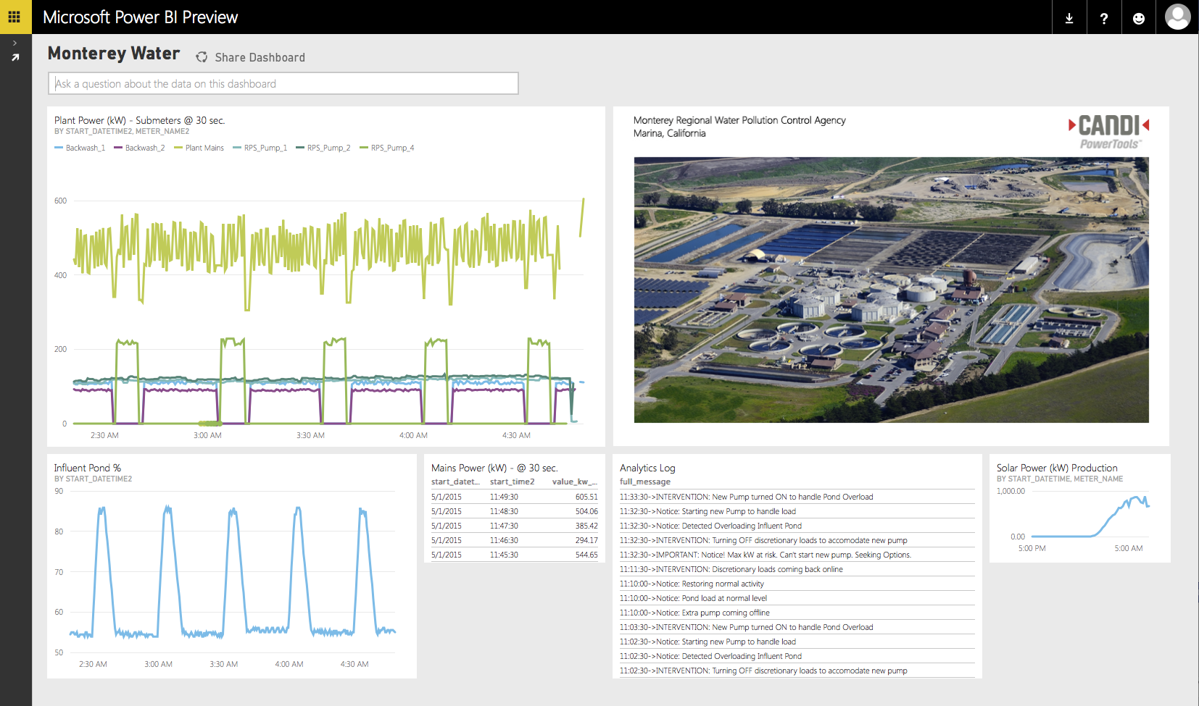
California
Data-driven irrigation with Azure Stream Analytics and Power BI eases water distribution in California.
Notes:
Monterey Water – operates a wastewater facility that recycles water to irrigate crops. Between the main plant and 25 pumping stations they treat 20 million gallons of water per day.
Problem – whenever demand for water exceeds capacity of the plan it storage reserves they need to tap into wells that require enormous pumps that consume huge amounts of electricity. Similar pumps are required to move water across various locations through the facility. Firing up a single pump can cost thousands of dollars.
Challenge – analyzing and making decisions on real time data to optimize on energy costs, water processing capacity at the plan, storage reserve capacity, to meet demand.
MRWPCA operates a wastewater facility that recycles water to irrigate crops across the southern Monterey Bay region. Between its main plant and 25 pumping stations, MRWPCA treats 20 million gallons of water per day.
Whenever demand for water exceeds the capacity of the plant and its storage reservoirs, wells must be tapped, requiring the operation of enormous pumps that consume huge amounts of electricity. Similar pumps are required to move water among various locations and processes throughout the facility. All of this makes MRWPCA a major consumer of electricity that is subjected to certain punitive tariffs. “At times just firing up a single pump can cost the agency thousands of dollars,” says Tom Kouretas, an engineer who focuses on energy issues at the facility.
“Trying to understand how best to optimize these processes and stay below peak energy demands means that the agency must understand when we are using power, what the price is on the grid, what the total load is of each process, how to distribute loads among various pumps, and how much the solar production contributes to power availability in the moment,” Kouretas says.

Slide 28


Using Power BI to combine and analyzing service data, revenue data, and macro-economic data to drive 3x increase in revenue.
Notes:
JOHN BUCCOLA: So we're an outsource provider of laundry services. We're the number one provider in Canada, number two provider in the United States. And essentially our product is our people and our customer service. So what we do is in a multi-family housing setting, where there is a laundry, shared laundry type of a setting, our customers use that equipment and we on behalf of the owners of that building will collect, service, and install that equipment for them. So we maintain it. We're essentially a facilities management and service company. We are a billion dollar company, valued at over $1 billion today and we're on our way to becoming a $3 billion company over the next five years, all through the application of Microsoft's technology.
JAMES PHILLIPS: So if I live in an apartment, or if I'm living in a dorm and I go down to the laundry room that's your stuff.
JOHN BUCCOLA: That's our stuff. So most of the universities in California, as an example, Stanford, UCLA, we've been doing laundry services at UCLA for over 50 years.
JAMES PHILLIPS: Wow.
JOHN BUCCOLA: So our average customer tenure is 23 years.
JAMES PHILLIPS: That's a long time.
JOHN BUCCOLA: Indeed.
JAMES PHILLIPS: So a lot has changed, by the way, over 23 years.
JOHN BUCCOLA: It has, absolutely. Over the past few years we embarked on a journey, as I shared earlier, to really going from being a laundry services provider to being a technology and services provider. We think of ourselves as a broker of technology and service.
JAMES PHILLIPS: And how have you used the Microsoft data platform to make that happen?
JOHN BUCCOLA: So our Microsoft data platform, it really starts with Dynamics for us, Dynamics CRM, Dynamics GP. We have a very rich implementation of WennSoft, as well. We have a great partner channel in TMC and others who have implemented our technology. And on top of that we have a very rich data warehouse. So our data warehouse, which was implemented a couple of years ago, really started coming to life over the past couple of years with the emergence of Power BI and the other suites around the Power BI platform.
JAMES PHILLIPS: Got it. And so we're talking in this section about data, more data, the ability to bring all your data together and I guess that's what the data warehouse does for you. What kind of data do you keep in there?
JOHN BUCCOLA: So our enterprise data within our four walls, if you will, our information about equipment that's installed, the service transactions that we've performed, and the revenue cycle transactions that we've performed, as well. And then the external data that, Power BI we're going to show in just a minute, really kind of tells a more rich story about our business. And what the data has done for us, James, is it's allowed us to grow our business more profitably than we otherwise could have without these insights. So we have really been now a pioneer in how we think about pricing and how we measure usage to get the optimal pricing for each of our customers in each of our 70,000 locations.
JAMES PHILLIPS: Let's go see what a high-tech laundry business looks like.
JOHN BUCCOLA: Let's go check it out. So a year ago we licensed Power BI very quickly and the first kind of tool we pulled out of the box, the first toy we pulled out was Power Map. So we have over 70,000 locations and before Power Map our ability to kind of take our data and put it on a map pretty limited. We were able to do this within a few minutes, with no programming at all. And so it was really exciting.
So what we're looking at here is actually our service data. And we just, again, drag and drop this onto the map here. And this is actually showing us the repairs per machine by manufacturer. So you'd expect that similar manufacturers would have a similar repair rate, or reliability rate. This allows us to normalize that and put it right on the map.
JAMES PHILLIPS: So what were those columns that were poking up?
JOHN BUCCOLA: So those columns that were poking up are actually our locations. So those locations let me just kind of go back to that, each of those 70,000 columns is a location and the height of the columns indicates the repairs per machine. So if it's higher it's no bueno. We don't like that.
JAMES PHILLIPS: Something is going wrong u in the Northeast there.
JOHN BUCCOLA: That's right. And it should be normalized across manufacturers, so there could be a house problem. We have house problems. We have user error, I hate to say it. But, then we have traditional machine problems, as well. And so we may have to do some user education problems and the Power BI story we're going to show in a minute will help us drill beneath this data to understand what those problems might be.
JAMES PHILLIPS: Got it.
JOHN BUCCOLA: So that's service data. We also think about revenue cycle. So what we're showing here is actually the revenue per machine. And again, this is very easy for us to just take drag and drop that information right onto the map and then show very quickly the productivity. These heat maps are showing money. This is showing revenue per machine that we're gleaning out of these machines.
Again, our customers, our residents in these apartment communities, they're putting either quarters in a machine or they're swiping a credit card or using some electronic payment system in every one of these 500,000 machines.
JAMES PHILLIPS: And do you have to choose one is coin one is card?
JOHN BUCCOLA: Typically there's one or the other, but we also have some that actually have both. So you can see these pink bars are actually going to indicate coin and card.
JAMES PHILLIPS: I see.
JOHN BUCCOLA: So about 60 percent of our revenue comes in from traditional means, so it's coins or dollar bills. That 40 percent is coming via electronics. We're payment system agnostic. We'll put in whatever makes sense. But what I shared in the earlier session, which I want to kind of showcase today, is we really have gleaned some unexpected insights about our business as it relates to payment systems.
Traditional thinking is, hey, just move everything electronic. You've got to be able to swipe a card. Okay, well, let me show you what that looks like. So what we're showing here is this is coin versus card revenues by location. Now the height of the bar is a good thing. This is the amount of revenue we're getting from that location. And the color of the bar, again, indicates the payment system itself.
Now we're going to overlay that gross per machine, so this is how productive these locations are. And so when I overlay that on top of this map, I'm starting to get a real picture here for at a location level how productive our machines are and how productive these locations are.
This is Southern California. We've got 50,000-plus machines in Southern California. We have 500,000 in North America. But now we're looking at Long Beach.
Let me tell you just a very brief story about Long Beach. It's the fifth largest city in California, has over 500,000 people, and we've got 8,000 machines in Long Beach. And most of them, you can tell from this light blue color, are coin operated. I also have some card operated machines that are here as well.
But what you'll notice is that the productivity of the coin machines is actually higher than the card machines. And the reason for that is essentially it's a demographic preference. The residents in these communities just simply prefer cash. That's how they want to interact with our service, so we let them do that.
We can collect either way. We can install either payment system. But in this particular example, that's what they prefer.
JAMES PHILLIPS: And that impacts your revenue.
JOHN BUCCOLA: That impacts our revenue. So in some cases, when we install the wrong payment system, we'll see revenues actually go down. Obviously, not a good thing.
So that's what Power Map has done for us. It's a great tool. It's visual. Just by its nature, it runs off of Excel. So when we think about distributing those insights, we think about Power BI.
This is what's really exciting for us is now taking the data that we just saw, along with all of our other enterprise data in our Dynamics ERP platform along with CRM, along with our other bespoke systems, our customer systems, teaming that data along with other data that's external and bringing that all together.
JAMES PHILLIPS: The heart rate monitor of your business.
JOHN BUCCOLA: It is. So this is a heart rate monitor for our business. So let's take service as an example. So here's our dashboard. We can now drive into service. Remember those tall bars in the northeast?
JAMES PHILLIPS: Yeah.
JOHN BUCCOLA: Let's go check out to see what the heck is going on there.
So as I click on this, it's going to take me to a page that's going to get deeper on the insights of the machines themselves. So now we're going to look at service calls by resolution, and we're going to look at the reasons for service calls normalized by manufacturer.
JAMES PHILLIPS: And what did you click there?
JOHN BUCCOLA: So what I just clicked here was -- we masked this because we want to protect our manufacturer partners.
JAMES PHILLIPS: Fair enough.
JOHN BUCCOLA: But I just clicked on one of our manufacturers, our predominant manufacturer. And it's telling us about the problems that we've seen for these service calls. And I can compare that to potentially another manufacturer from whom I'm buying. And in some cases, I may want to go back to that manufacturer and work with them, which we do. Or I may think about a certain geography and think through, okay, I've got to work on a user education for this new type of equipment that we just installed.
JAMES PHILLIPS: Got it.
JOHN BUCCOLA: So this is going to give me all that.
This is the other cool thing about Power BI. I can make any of these metrics that are shown here, I can surface those on my main dashboard.
JAMES PHILLIPS: So you pin them back just like I was showing.
JOHN BUCCOLA: I pin them back. And so we've taken the data and we've essentially said, you know what, IT is getting out of the business of cosmetics and how data is presented. IT is in the business of being a steward of that data, but a broker of services, not a builder anymore, but a broker of these services.
JAMES PHILLIPS: That was hard to do in the past.
JOHN BUCCOLA: It was very hard to do. And Power BI is a platform that just allows us to take this and essentially give it to the business and let the business decide what they want to see. It's no longer sort of the stone tablets of reporting.
JAMES PHILLIPS: Right.
JOHN BUCCOLA: It's all live data, it's all surfaced right here. And now I took that one metric we saw earlier and I've pinned that to my dashboard. I can take that and can be alerted for any kind of an exception that's flagged, or if it trips over a certain threshold.
JAMES PHILLIPS: Got it.
JOHN BUCCOLA: So that's service. I'm going to quickly go through these last two.
We can grow our business in one of two ways. We're a billion-dollar business today, we're going to quickly become a $3-billion business by penetrating new markets, by opening new verticals, and also by managing and optimizing pricing.
So as I think about new offices, we have a concept we call the micro branch. Micro branch is basically a small implementation of our service, but has all of our technology.
So I look at Miami. So we've determined through the use of data and the studies that we've done, through econometric modeling, that gas prices and certain weekly wages, unemployment rates, these are external factors that create an optimal environment for our service.
We know that when gas prices fall to a certain level and unemployment falls to a certain level and weekly wages rise to a certain level that our product, our service is going to go up, the usage of that service.
And so what this is showing me is I can say, "Which markets do I want to look at potentially entering?" With this micro branch concept, we decided that Miami was the right market for us. So we just opened the doors in Miami about three and a half weeks ago.
JAMES PHILLIPS: Congratulations.
JOHN BUCCOLA: Really excited about that. And we've got a couple more on the way. But that kind of insight that I'm able to determine which market to enter into, I can surface.
JAMES PHILLIPS: And once you've entered that market, can you use the platform to understand if it was a good decision?
JOHN BUCCOLA: That's exactly right. So we went into the Phoenix market, just completely green field. Planted our flag, set up shop there, and we've been very pleased with our performance there. We can show all that performance and how it's been tracking versus our plan all through these systems.
JAMES PHILLIPS: Great.
JOHN BUCCOLA: So last point I want to show on Power BI is pricing. Pricing is huge for us. We have 70,000 locations. What should the price of laundry be at each of our locations? I don't know. And a human really can't know. That's what we discovered over many, many years of trying to sort of solve this riddle.
JAMES PHILLIPS: Throwing darts?
JOHN BUCCOLA: It's throwing darts. And so we spent a long time trying to figure out, what is the best way for us to determine what the price of laundry should be for that location? We don't want to over price. If we over vend, then our customers are going to go elsewhere. And then if we under vend, we're missing out on an opportunity for our customers because we split revenue with our customers.
JAMES PHILLIPS: Interesting.
JOHN BUCCOLA: So we want to get that just right. And so what we found was these factors, along with a few others, by putting this together with our data and our enterprise data, we're able to get a better flow-through rate of usage by optimizing these metrics. So I can take this information, Power BI does this for me. In the old days, crawl through spreadsheets. Crawl through government spreadsheets, put all this census data in, gas prices, all this stuff, and it needs to get updated all the time.
With Power BI, all this information gets funneled right here. And it's in terms I understand. So now I can see the gas prices and the unemployment rate in Hayward, as an example, that's our East Bay market just outside of San Francisco. I can see exactly what weekly wages are doing there, I can see what's happening with unemployment, I can see what's happening with gas prices. These are favorable trends for us and for our business.
So Power BI has been very powerful for us to take all this information, put it in one place. Not only our internal data, but to surface insights about our business even through the lens, potentially, of macro-economic data.
JAMES PHILLIPS: So John showed you that by taking various kinds of data, he had service data, he had revenue data, he had macro-economic data, by pulling all that together, using Power BI, he had the opportunity to learn things that move the needle for his business. They've seen a 3X increase in their revenue as a result of the ability to price based on this data.

Slide 29

MediaCom
“Power BI will fundamentally change the way we manage campaign performance.”
Lowell Simpson CIO
Notes:
Video: https://www.youtube.com/user/mscloudos/custom?x=us-en_casestudiesrds_332_12
Case Study: http://www.microsoft.com/casestudies/Power-BI-for-Office-365/MediaCom/Global-Media-Agency-Expects-Better-Campaigns-and-Multimillion-Dollar-Gains-from-Cloud-BI/710000003916
Video: https://www.youtube.com/user/mscloudos/custom?x=us-en_casestudiesrds_332_12
Case Study: https://customers.microsoft.com/Pages/CustomerStory.aspx?recid=16390
Case Study Summary:
MediaCom uses Power BI for Office 365 to analyze and gauge the effectiveness of the campaigns the company creates for its clients. Using the powerful Microsoft business intelligence tools to analyze paid and earned media activity, MediaCom can quickly optimize campaign performance and spend across every media channel. The process is efficient, drives better performance, and increases productivity by up to millions of dollars per campaign.
Slide talk track:
MediaCom directs omni-channel campaigns for global enterprise clients including P&G, Coca-Cola, and Volkkswagen.
MediaCom wanted a simple, immediate, and intuitive way to measure the health of an ad campaign run for some of its biggest and most diverse clients.
The company needed a way to collect and integrate results from TV, print, radio, search, display, event sponsorships, and the web to determine the success of a campaign and the value returned to the client, especially over time—represented by a composite score.
MediaCom, together with Microsoft, created a “health check” that quickly captures the many facets of a multi-platform media campaign in a single score.
The media agency conducted a proof of concept using Power BI for Microsoft Office 365, with Power BI tools used through the Excel spreadsheet software—something with which account managers were already familiar.
MediaCom used Power BI to discover, merge, and visualize data from multiple third-party data sets. The agency then used Power BI to bring the data sets into a unified campaign dashboard for the client, enabling real-time data analysis and reports that can influence and improve campaign planning and performance.
With Power BI for Office 365, MediaCom can facilitate faster, more-effective campaign management and productivity gains that can add millions of dollars in value per campaign.
The agency will be able to constantly monitor campaign activity, responding quickly and effectively to resolve small issues before they can escalate.
MediaCom can keep clients better and more frequently informed on the status of campaigns, with more meaningful conversations about brand strategy and growth.

Slide 30


“We knew if we could create a level of transparency using the Microsoft Power BI dashboards, we could completely transform the way we were making decisions. And we have.”
Dave Rumsey
Chief Information Officer, Tourism Australia
Notes:
https://customers.microsoft.com/Pages/CustomerStory.aspx?recid=23330

Slide 31



“We go live with mobile banking, and in less than a week we have a full business intelligence suite to track it. Power BI was instrumental in this.”
Bruce Rioch
Head of Information and Customer Systems, Metro Bank
“Before, you really thought twice before ordering a custom report…Now, if you have a question, you can use Power BI to find the answer. There’s no barrier between you and the analysis you want to perform.”
Alessandra Gilberti
Business Intelligence Manager, ABB Italy
“The ability to ask any question you like and then see data immediately returned leads to more-informed conversations. Power BI Q&A will change the way the whole organization thinks and interacts.”
Christopher Reynolds
VP of Data and Marketing Analytics, Conde Nast
“We knew if we could create a level of transparency using the Microsoft Power BI dashboards, we could completely transform the way we were making decisions. And we have.”
Dave Rumsey
Chief Information Officer, Tourism Australia

Slide 32


“We can now use SQL Server Reporting Services and Analysis Services to create reports quickly and return them to people in a day. And with those time savings, our staff time is freed up to work on other things…The solution has transformed the way we operate.”
Mark Walsma
BI Product Manager, Aon Benfield
Notes:
https://customers.microsoft.com/Pages/CustomerStory.aspx?recid=12068
----
Alternate Quote: “With SQL Server…, our colleagues can obtain a central view of all global reinsurance data, which they can easily slice by geography or business role and drill down to investigate anomalies. It makes them more comfortable in their data analysis.”
Barry Walhof
Senior BI Architect, Aon Benfield

Slide 33


“With a Microsoft BI solution based on SQL Server, we can quickly spin up reports and performance indicators. It’s an enabling platform, and we can do things now fairly simply that we couldn’t have dreamed of in the past.”
Marlo Valente
Head of Enterprise Services, Leicester City Council
Notes:
https://customers.microsoft.com/Pages/CustomerStory.aspx?recid=3883

Slide 34



BOTS OF ANARCHY
BO
@ortizlopez91
¿Estudiante? esdpeestudiantes@microsoft.com
¿Profesor? esdpeprofesores@microsoft.com
¿Emprendedor? esemprendedores@microsoft.com
¿Comunidad Técnica? escomunidades@microsoft.com
¿Fabricante de Software? esisvbd@microsoft.com
¿Desarrollador? esmsdn@microsoft.com
Notes:
Slides, Demos & Lab:
http://github.com/xamarin/dev-days-labs

